Slide 1
DataBase Management System (DBMS)
Asma El Kissi

Slide 2
Contents
Introduction
MySQL
PostgreSQL
SQL SERVER
Comparison
References

Slide 3
Introduction
A relational database is a set of tables (datasets with rows and columns) that contain information relating to other tables in the database.
SQL (Structured Query Language), is the standard language for interacting with relational databases.
We will focus on three of the most popular database management systems : MySQL, PostgreSQL, and SQL Server

Slide 4
MySQL
MySQL is the most popular MDBS. It is used by Google, LinkedIn, Amazon, Netflix, Twitter, and others.
Language : C++
The database management is done with Structured Query Language.
Price: the database solution is developed by Oracle and has additional paid tools; the core functionality can be accessed for free.

Slide 5
PostgreSQL
PostgreSQL is the most advanced open-source MDBS on the market. It is used by Apple,Skype, Cisco, Etsy
Language: C
Price: open-source

Slide 6
SQL SERVER
The SQL Server infrastructure includes a lot of additional tools, like reporting services, integration systems, and analytics. For companies that manage multiple teams, these tools make a big difference in day-to-day work. Is is used by JPMorganChase, Bank of America, UPS, Houston Methodist
Language : C, C++
Price:
The database has a free edition for developers and small businesses but only supports 1 processor, 1GB of maximum memory used by the database engine and 10GB maximum database size
For a server, users need to pay $931.

Slide 7
Comparison
PostgreSQL, and MySQL use very similar syntax, with some notable differences highlighted below. Microsoft SQL Server has the greatest contrast in SQL syntax, as well as a wide variety of functions not available in other platforms.
Table I highlights some examples of basic differences between SQL platforms.
The authors in [2] detailed the difference in functionalities between the SQL platforms in : data changes, defragmentation, data queries, temporary tables, indexes, memory-optimized tables, JSON support, partitioning.

Slide 8
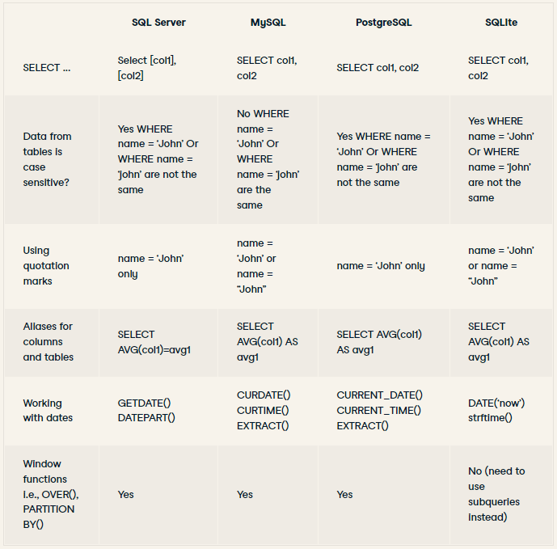
Comparison
Table I: Basic differences between SQL platforms [1]

Slide 9
References
[1] : SQL Server, PostgreSQL, MySQL... what's the difference? Where do I start? | DataCamp
[2] : SQL Server vs MySQL vs Postgresql: Which One Is the Best (jelvix.com)

